Slide 1
YOUTUBE SONG ANALYSIS USING POWER BI
HARSHA LAL

Slide 2
Problem Statement
This internship project aims to conduct a comprehensive analysis of YouTube songs data using Power BI.
The dataset contains key attributes such as video ID, channel title, title, description, tags, published date,
view count, like count, favorite count, comment count, video duration, video definition, and caption
details. The goal is to utilize Power BI to create insightful visualizations and reports that provide a deeper
understanding of YouTube songs' performance, popularity, and user engagement. The analysis aims to
uncover trends, preferences, and patterns in the data to aid content creators and stakeholders in
optimizing their YouTube song content.

Slide 3
Dataset Overview
1. video_id: Unique identifier for each YouTube video.
2. channelTitle: Title of the YouTube channel publishing the song.
3. title: Title of the YouTube song video.
4. description: Description provided for the YouTube song video.
5. tags: Tags associated with the YouTube song video.
6. publishedAt: Date and time when the YouTube song video was published.
7. viewCount: Number of views received by the YouTube song video.
8. likeCount: Number of likes received by the YouTube song video.
9. favoriteCount: Number of times the YouTube song video has been marked as a favorite.
10. commentCount: Number of comments posted on the YouTube song video.
11. duration: Duration of the YouTube song video.
12. definition: Video definition or quality (e.g., HD, SD).
13. caption: Availability of captions for the YouTube song video.

Slide 4
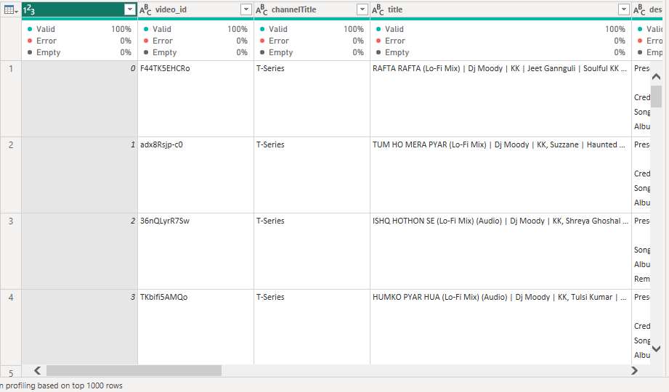
Data Cleaning and Preparation

Slide 5
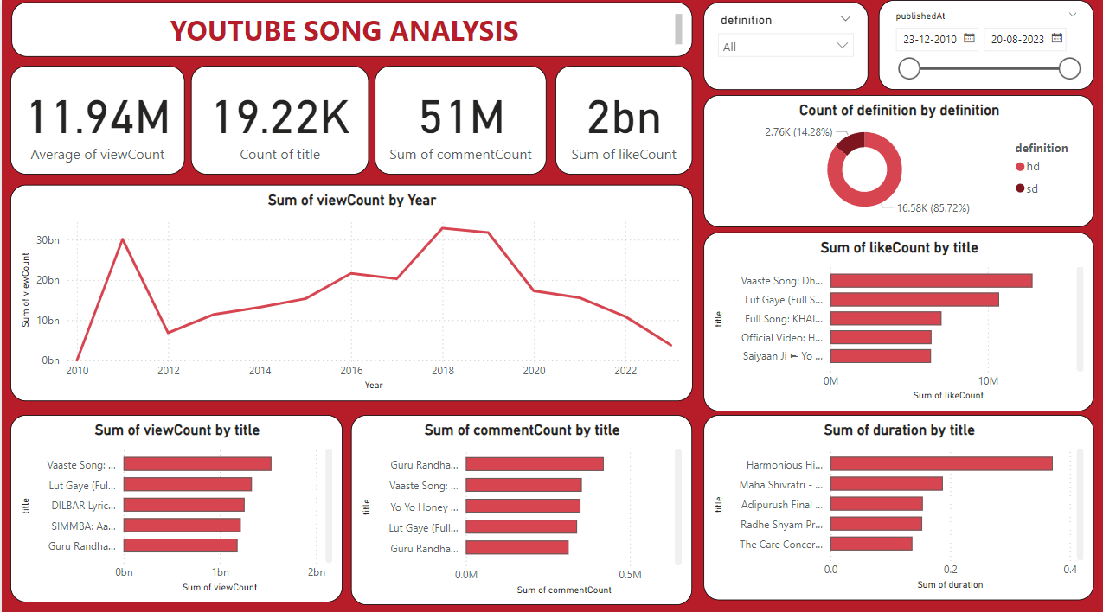

Slide 6
Thank you

